Slide 1
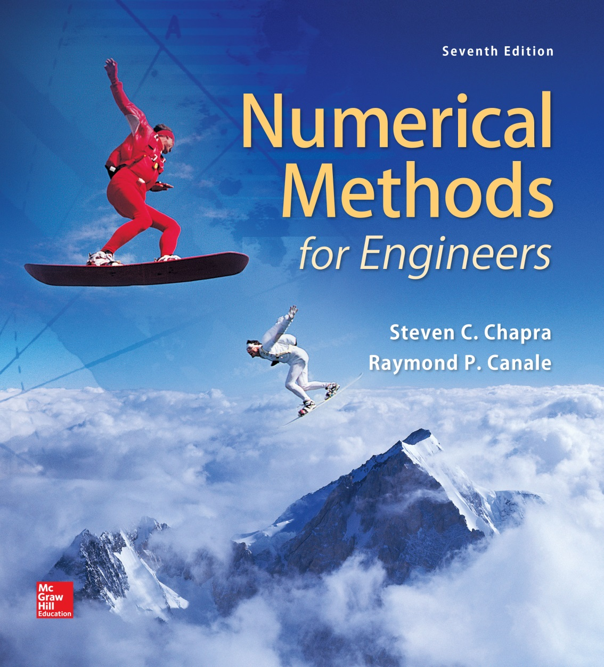
Part 4 - Chapter 13

Slide 2
Optimization
Part 4
Root finding and optimization are related, both involve guessing and searching for a point on a function.
Fundamental difference is:
  Root finding is searching for zeros of a function or functions
  Optimization is finding the minimum or the maximum of a function of several variables.

Slide 3
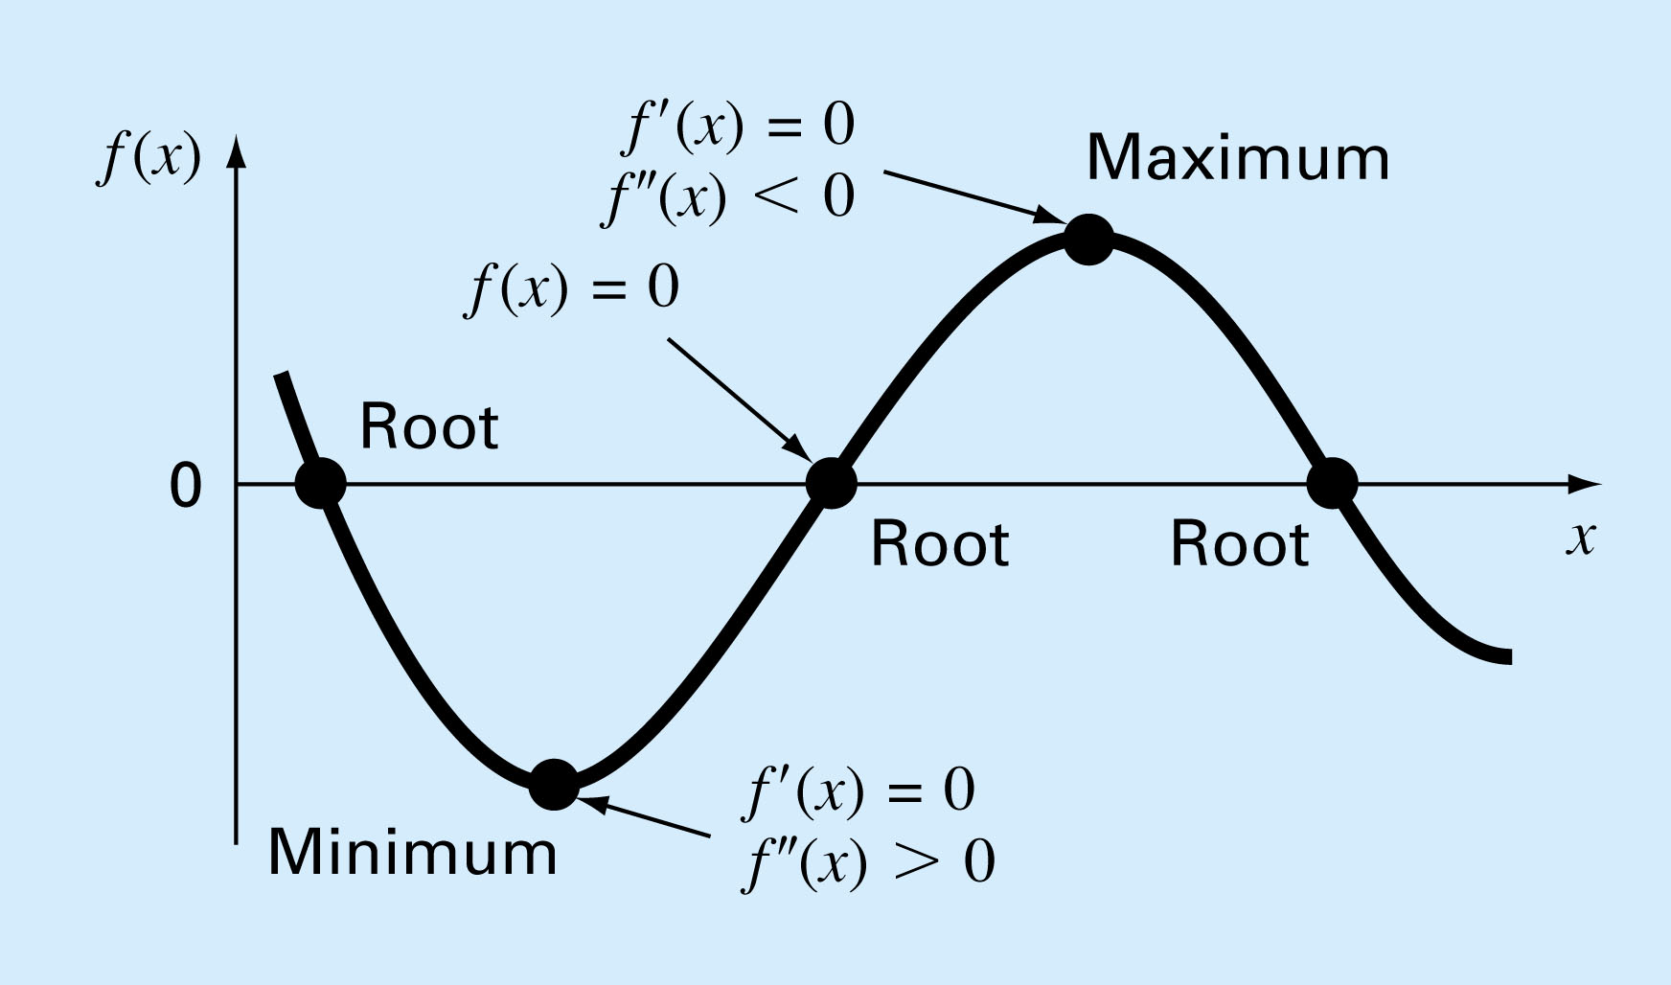
figure PT4.1

Slide 4
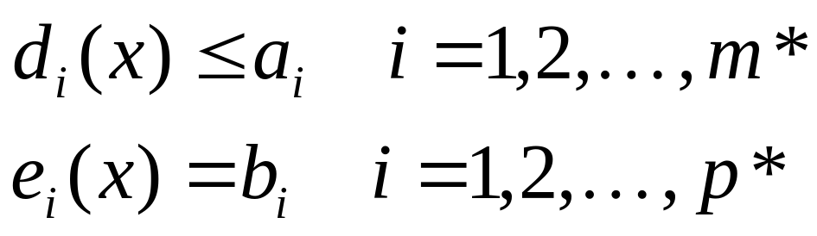
Mathematical Background
An optimization or mathematical programming problem generally be stated as:
Find x, which minimizes or maximizes f(x) subject to
Where x is an n-dimensional design vector, f(x) is the objective function, d_{i}(x) are inequality constraints, e_{i}(x) are equality constraints, and a_{i} and b_{i} are constants

Slide 5
Optimization problems can be classified on the basis of the form of f(x):
  If f(x) and the constraints are linear, we have linear programming.
  If f(x) is quadratic and the constraints are linear, we have quadratic programming.
  If f(x) is not linear or quadratic and/or the constraints are nonlinear, we have nonlinear programming.
When equations(*) are included, we have a constrained optimization problem; otherwise, it is unconstrained optimization problem.

Slide 6
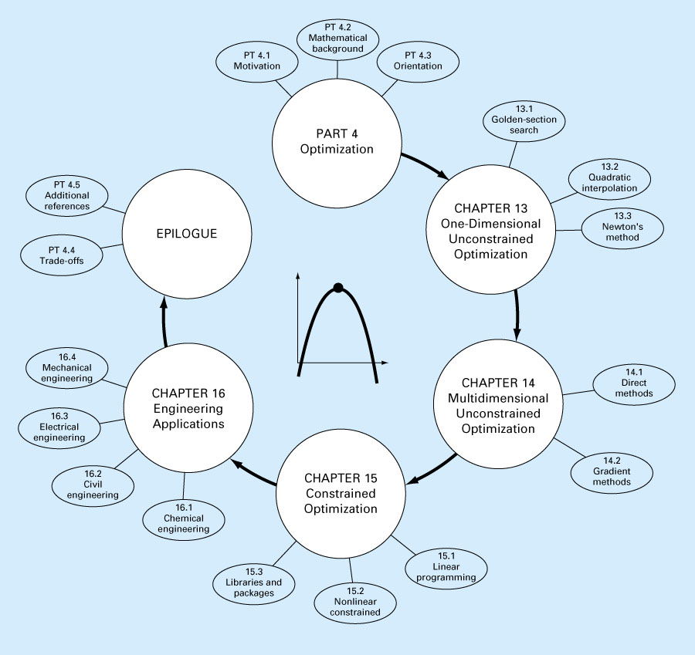
Figure PT4.5

Slide 7
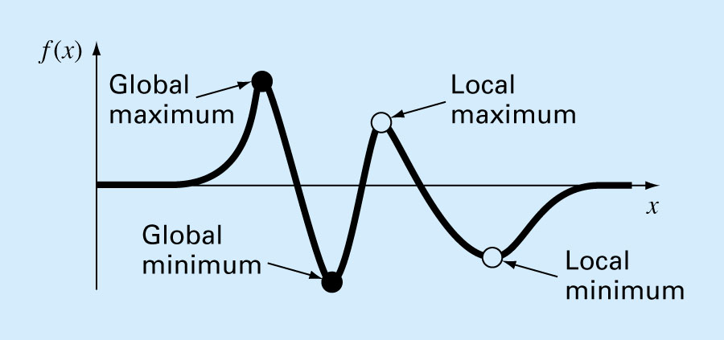
One-Dimensional Unconstrained Optimization
Chapter 13
In multimodal functions, both local and global optima can occur. In almost all cases, we are interested in finding the absolute highest or lowest value of a function.
Figure 13.1

Slide 8
How do we distinguish global optimum from local one?
By graphing to gain insight into the behavior of the function.
Using randomly generated starting guesses and picking the largest of the optima as global.
Perturbing the starting point to see if the routine returns a better point or the same local minimum.

Slide 9
Golden-Section Search
A unimodal function has a single maximum or a minimum in the a given interval. For a unimodal function:
  First pick two points that will bracket your extremum [x_{l}, x_{u}].
  Pick an additional third point within this interval to determine whether a maximum occurred.
  Then pick a fourth point to determine whether the maximum has occurred within the first three or last three points
  The key is making this approach efficient by choosing intermediate points wisely thus minimizing the function evaluations by replacing the old values with new values.

Slide 10
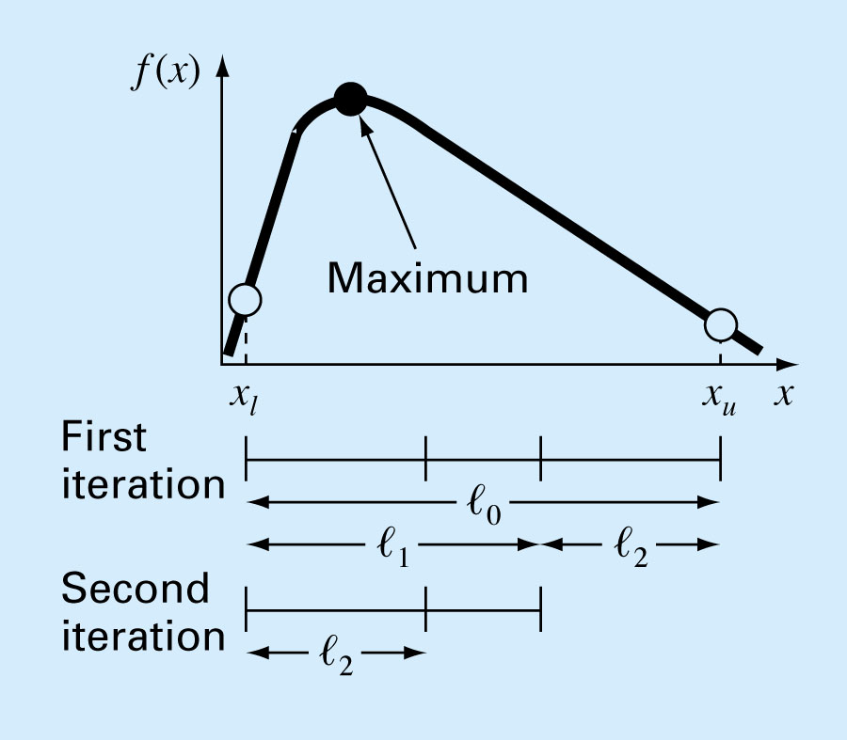
Figure 13.2

Slide 11
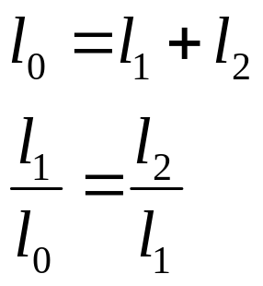
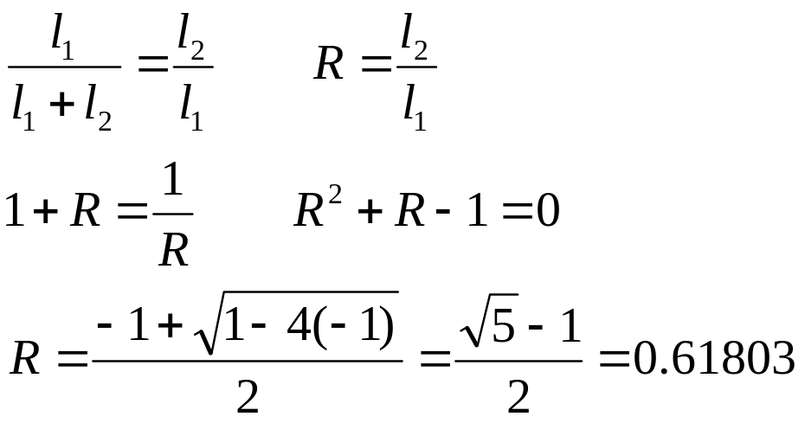
The first condition specifies that the sum of the two sub lengths l₁ and l₂ must equal the original interval length.
The second say that the ratio of the length must be equal
Golden Ratio

Slide 12
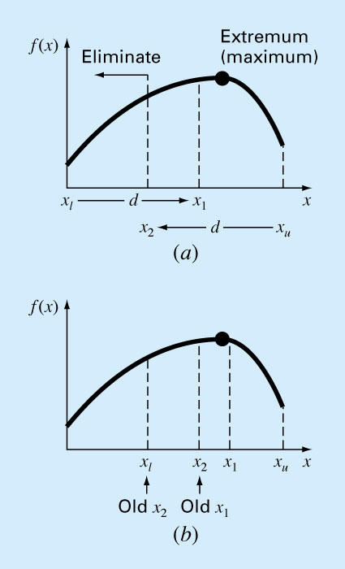
Figure 13.4

Slide 13
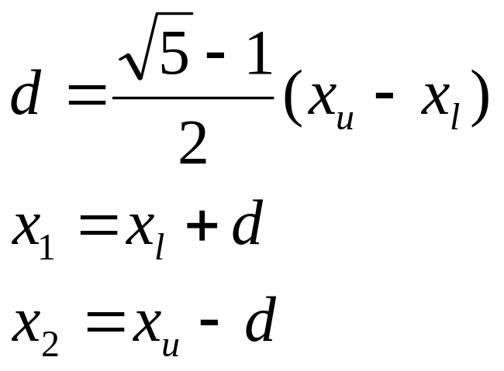
The method starts with two initial guesses, x_{l} and x_{u}, that bracket one local extremum of f(x):
Next two interior points x₁ and x₂ are chosen according to the golden ratio
The function is evaluated at these two interior points.

Slide 14
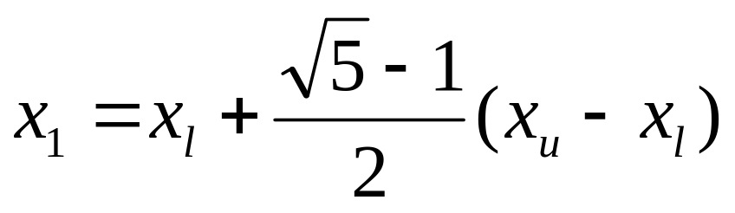
Two results can occur:
If f(x₁)>f(x₂) then the domain of x to the left of x₂ from x_{l} to x₂, can be eliminated because it does not contain the maximum. Then, x₂ becomes the new x_{l} for the next round.
If f(x₂)>f(x₁), then the domain of x to the right of x₁ from x_{l} to x₂, would have been eliminated. In this case, x₁ becomes the new x_{u} for the next round.
New x_{1 i}s determined as before

Slide 15
The real benefit from the use of golden ratio is because the original x₁ and x₂ were chosen using golden ratio, we do not need to recalculate all the function values for the next iteration.

Slide 16
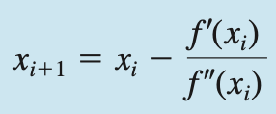
Newton’s Method
A similar approach to Newton- Raphson method can be used to find an optimum of f(x) by defining a new function g(x)=f‘(x). Thus because the same optimal value x* satisfies both
f‘(x*)=g(x*)=0
We can use the following as a technique to the extremum of f(x).

Slide 17
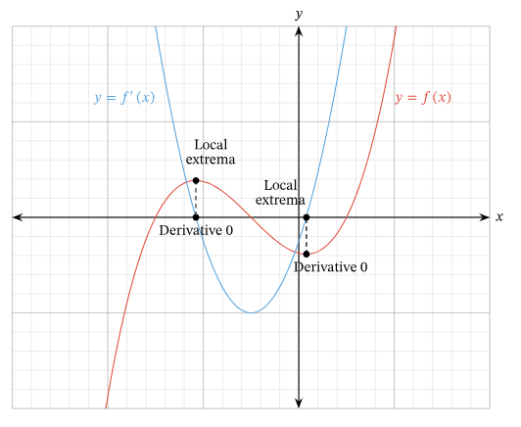

Slide 18
